Slide 1
Technical Support (420-1N6-AB) Hardware: External Components
Lecture from Fall 2022 Adapted for Fall 2024

Slide 2
Computer Basics
Notes:
Lecture notes go here

Slide 3
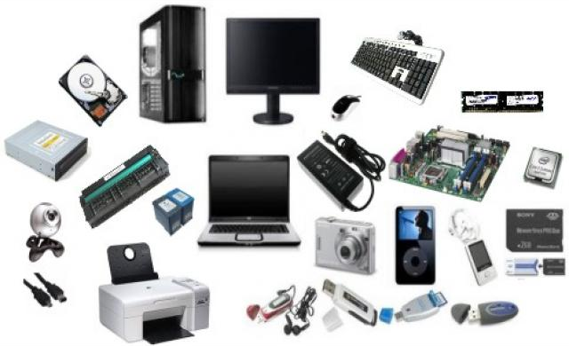
Hardware vs Software
Hardware
The physical components that make up a computer system.

Slide 4

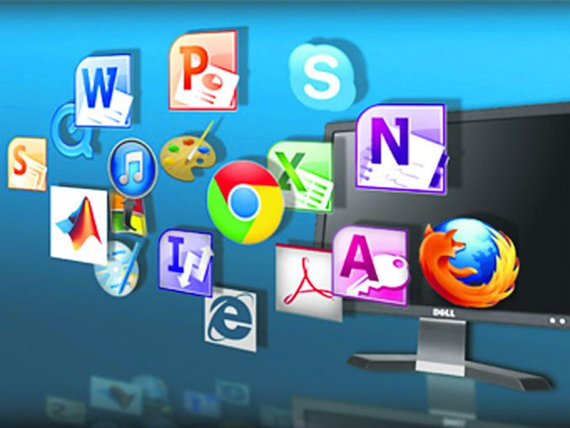
Hardware vs Software
Software
The programs (instructions) that tell the computer (the hardware) what to do.

Slide 5
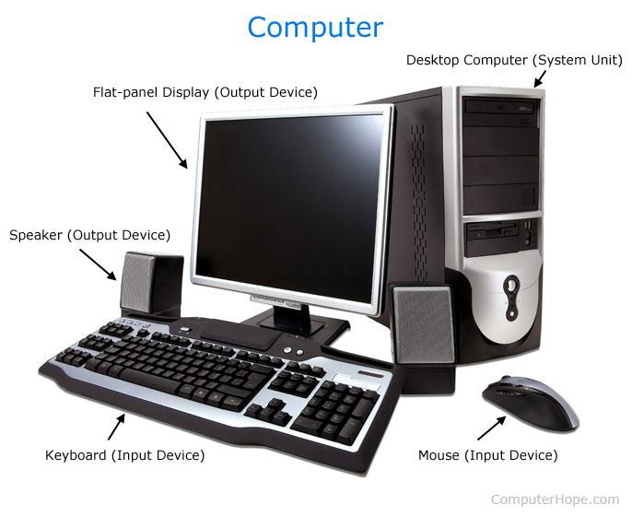
What is a computer?
A computer is an electromechanical device designed to (1) store information and (2) change that information through human and programmatic interaction (processes)
Two basic properties of processes:
Deterministic: A given input reliably produces the same output every time
Digital: All “information” is represented by combinations of two different states (0 or 1, i.e., ON or OFF). This digital information can be shared between devices using cables (whether electrical or optical, as we will see)
Notes:
‹#›

Slide 6
What is a computer? (cont.)
For all of the hardware devices that we learn about today, there is a lot of scientific detail. Do not focus on memorizing everything -- instead, focus on:
Deterministic: How can this physical device reliably produce the same output every time I provide the same input?
Digital: How can this physical device produce digital data that is useful for a computer?
Notes:
‹#›

Slide 7
Input and Output Devices

Slide 8
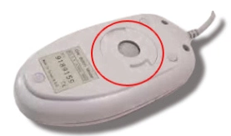
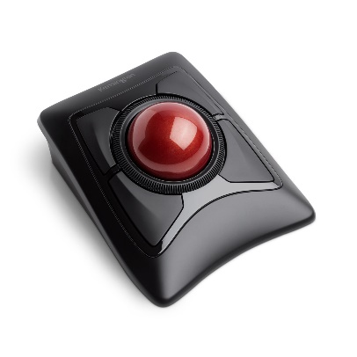
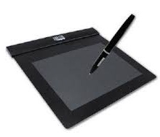
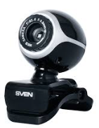
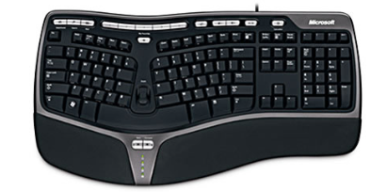

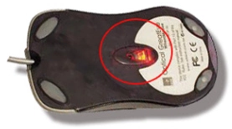
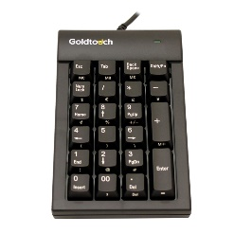
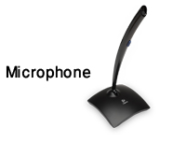

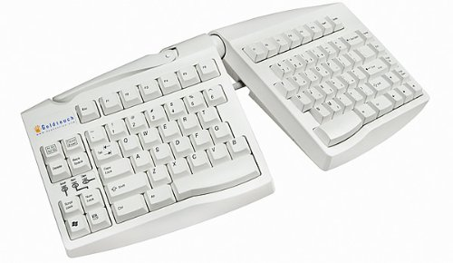
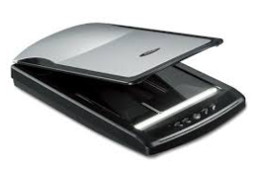
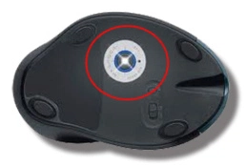

Input Devices
Allow a computer to accept data and instructions from a user.

Slide 9
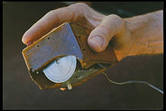



Input Devices: Mouse
Used to navigate the graphical user interface (GUI).
There are many types of mice, distinguished by tracking technology and by use case
Technologies:
Mechanical mice use a ball to measure movement (obsolete now -- why?)
Optical mice use light sources (first LED, then more precise Laser). https://en.wikipedia.org/wiki/Optical_mouse
Purposes:
Many! “Gaming” (many buttons), Ergonomic (optimize human comfort), etc.

Slide 10

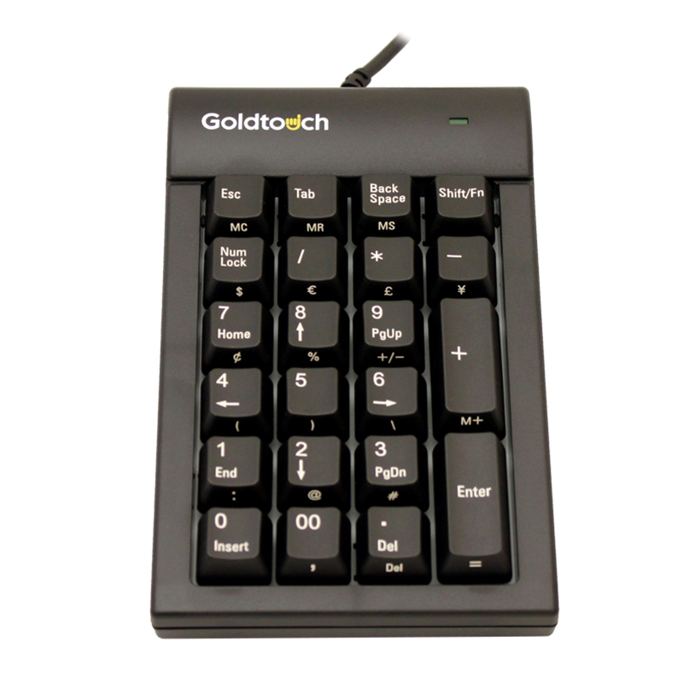
Input Devices: Keyboard
Used to enter text commands.
Most commonly used is the QWERTY layout (1873).
Other layouts include QWERTZ (Germany/Switzerland) and AZERTY (France) and DVORAK (nerds*)
Variations include wired or wireless keyboards and numeric keypads.
Ergonomic designs are recently becoming more popular.
KVM ("keyboard, video and mouse"): control multiple devices from one keyboard/mouse combination
* note: this is very hypocritical coming from me. don’t mind my bad jokes!

Slide 11
Input Devices: Others
Gamepads or joysticks are used for playing games and running simulations.
Digital / video cameras and webcams create images and videos.
Biometric devices use features unique to an individual user (e.g. fingerprint).
Touchscreens have a pressure-sensitive panel.
Scanners digitize images or documents so they can be stored as files.
Digital Tablets (sometimes called Digitizers) allow the user to create images or artwork using a stylus.
Media card readers read/write data from/to different types of media cards (SD cards, video game cartridges, etc.)

Slide 12

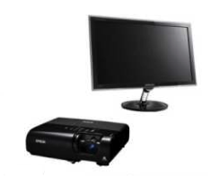
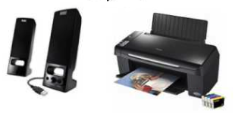
Output Devices
Output devices present information to the user from a computer.
Monitors
Projectors
Printers
Speakers
Headphones

Slide 13
Output Devices: Monitors
Different types of monitors use different technologies to create an image.
However, the common principles are the same:
Digital representation of image to display is sent to the monitor
The monitor produces each pixel (the “atom” of monitor displays) using some deterministic physical technology
Light from the monitor reaches us as a useful/pleasing image.
The following slides are the main technologies used today (from oldest to latest)

Slide 14
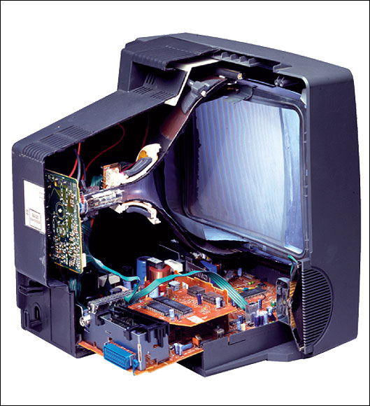
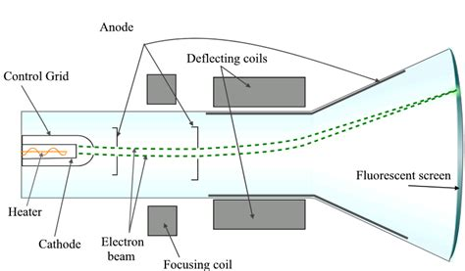
Output Devices: Monitors (cont.)
CRT (Cathode ray tube)
Very complicated, very cool, moderately dangerous, mostly obsolete!
The most common type of consumer and industry television before ~2010
Basically: a tungsten coil is heated in a vacuum until it sheds electrons, those electrons are accelerated by an electric field and guided by magnets to hit a phosphor coated glass display to emit light in a pixel grid
Obsolete since today their are lighter, simpler higher resolution technologies
Still used today for some applications due to zero latency. For instance, I use one for playing NES Tetris! (see the end of the Lecture 0 slides)

Slide 15
Output Devices: Monitors (cont.)
Plasma
Tiny cells of ionised gas that light up when stimulated by electricity.
Often used in home theatre applications due to accurate video representation.
High levels of brightness, deep black levels and very wide colour range.
Have shorter life span, susceptible to “screen burn-in” (this is why screensavers are called “screen savers”! Same for CRT).
DLP (Digital light processing)
Used in projectors.
Spinning colour wheel with microprocessor-controlled array of mirrors.
Each mirror corresponds to a specific pixel, reflecting light.
Monochrome image is created using up to 1024 shades of grey.
Colour wheel then adds to complete the projected image.

Slide 16
Output Devices: Monitors (cont.)
Finally, the most modern monitor technologies (used in our labs, most computers, laptops). They’re ordered approximately in order of lowest -> highest quality, though pros and cons exist for each (see here: https://en.wikipedia.org/wiki/Comparison_of_CRT,_LCD,_Plasma,_and_OLED_displays ).
LCD (Liquid crystal display)
Commonly used in flat panel monitors and laptops.
Consists of a white backlight (in light, white = all colours combined), two polarizing filters, and liquid crystal solution between them to transform the backlight into a coherent pixel grid.
An electronic current aligns and controls the crystals so that light can pass through them.
LED (Light emitting diode)
An LCD display that uses LED backlighting instead of a white backlight to light the display. The brightness of each RGB LED is controlled programmatically to produce each pixel
Thinner (no layers), lighter and brighter, and displays better contrast.
Lower power consumption.
OLED (Organic LED)
Similar to LED, but no backlighting required -- the material used to create these displays emits light when an electrical current is applied.
Allows for perfect representation of dark colours unlike all other monitor technologies. Also allows for flexible and transparent monitors
More expensive to produce, more susceptible to screen-burn-in than LCD or LED (but better than Plasma and CRT in this respect)
Here’s a great video (8 mins) explaining both physical and software technologies required to make the above monitors work: https://www.youtube.com/watch?v=uyLDA9QT8EY

Slide 17
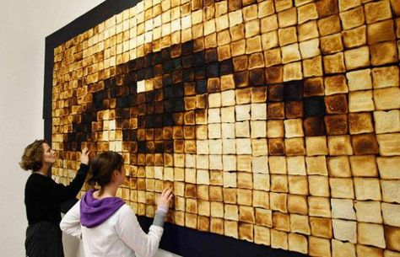
Output Devices: Printers
Printers take data from a computer and generate output on paper.
Basic principles
Similar to monitor (high quantity of small, well placed “pixels” → the visual quality of a coherent image)
Rather than orienting light photons on a screen, printers deposit liquid stains on to paper. The physical setup is different, but the same principles are at work.
A high enough quantity of toasted bread produces the qualitative impression of a human eye in this “piece” of art. Printers (and monitors) use much higher quantities of “pixels” than depicted here!

Slide 18
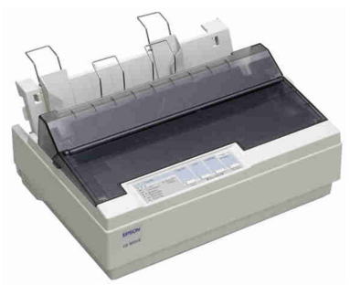
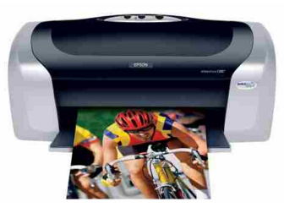
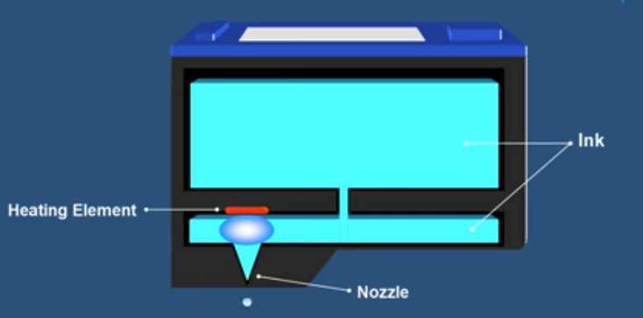
Output Devices: Printers (cont)
Dot-matrix printers
Uses print heads containing pins which produce patterns of dots on the paper by mechanical impact (pressing).
Inexpensive and typically print at a speed of 100 - 600 characters per second.
(Optional) See https://en.wikipedia.org/wiki/Dot_matrix_printer for more detail on history and technology
While still in use for particular applications (printing receipts for e.g.), these are now obsoleted by...
Ink-jet printers
Uses tiny droplets of ink to produce images.
Heat is applied to an ink reservoir, which pushes ink bubbles through a nozzle in a controlled manner.
The ink liquid droplets are smaller in diameter than a human hair! Many of these added together produce the quality of a coherent image.
Quieter than dot-matrix, and also provide better speed and higher quality.
Ink jet cartridge operation. Image source: https://www.youtube.com/watch?v=JEVurb1uVFA

Slide 19
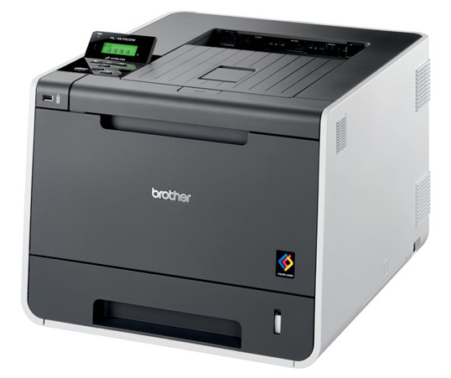
Output Devices: Laser Printers
Expensive when they were initially introduced.
Produce high-quality output quietly at a high speed.
Produces images by directing a laser beam at a mirror which bounces the beam onto a drum.
The drum contains a special coating to which the toner (ink powder) sticks.
A laser beam then conveys information to the drum, neutralizing and detaching some toner.
As the paper rolls by the drum, the toner is transferred onto the paper. A hot roller then bonds toner to the paper.

Slide 20
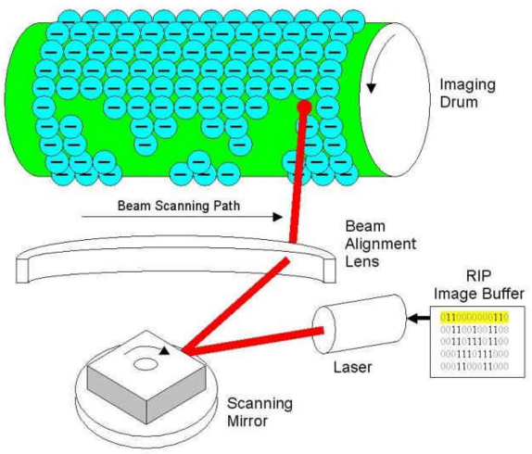
Output Devices: Laser Printers (cont.)
(end here: the drum rolls along the paper, transferring toner to the page in the pattern according to the laser’s drawing)
(start here)

Slide 21
Connectors (how to get the computer to talk to these output devices!)

Slide 22
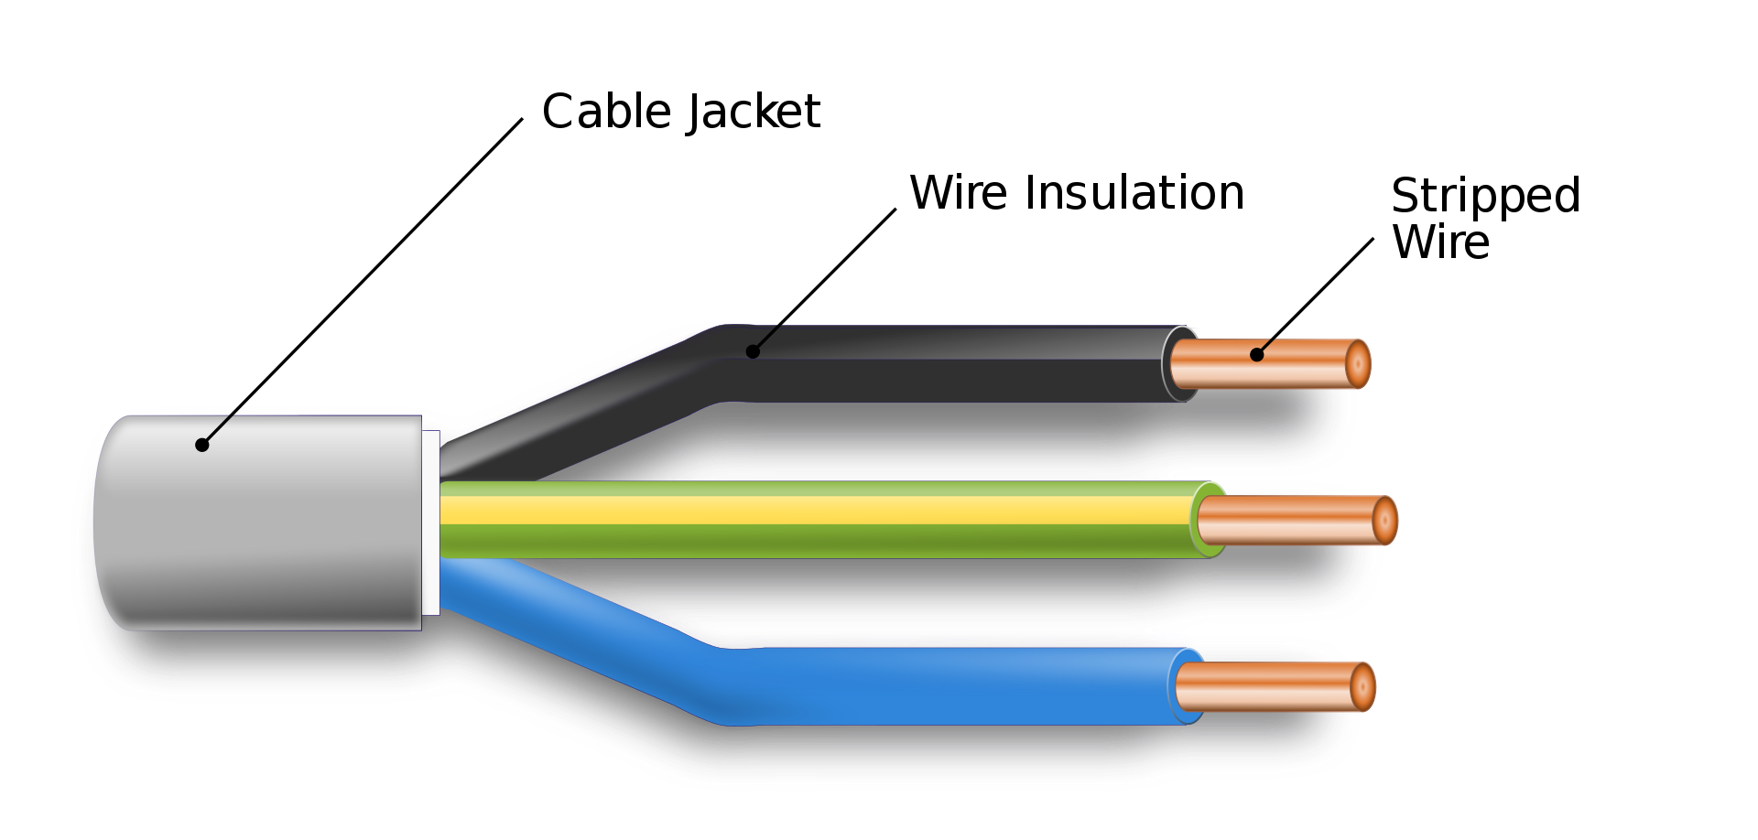
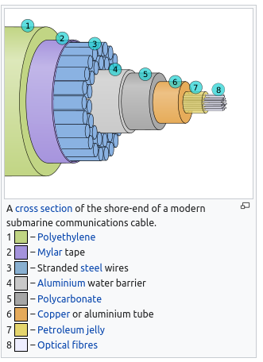
Connectors: Two basic types in general
Electrical cables
transmit an electrical signal on a conducting wire, insulated to protect the signal/surroundings
(2) Optical cables
transmit signal in the form of light
very fast! (speed of light in glass)
extensive global submarine network is the physical basis of the internet
A short (5 page) comparing the two cable technologies in more detail https://optronicsplus.net/downloads/whitepapers/OP_Fibre_Optics_vs_Copper_Cabling_Understanding_the_Difference_White_Paper_Rev.1.0.pdf

Slide 23
Output Devices: Cables
Some technical terms:
Cable (electric): The insulated copper wire that carries electrical/digital signals from devices to/from computers
Port: The slot where the insertable end of USB cable is connected to the computer
“Male” / “Female” cable ends: Distinguishing between the insertable end and the receptacle end for cables
Converter: A device that allows different standards/types of connectors to be used together

Slide 24

Connectors: USB
Universal Serial Bus (we’ll talk about the meaning of the last two words soon!)
Used to connect most newer devices to computers.
Can transmit both power (e.g. charging phones) and information (data)
Despite being “Universal” there are an incredible number of USB types. We’ll cover those on the next slide.

Slide 25
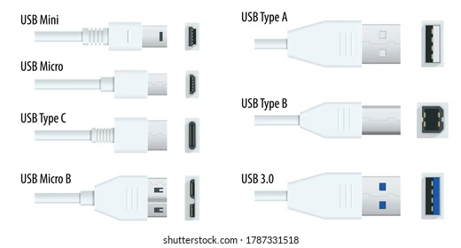
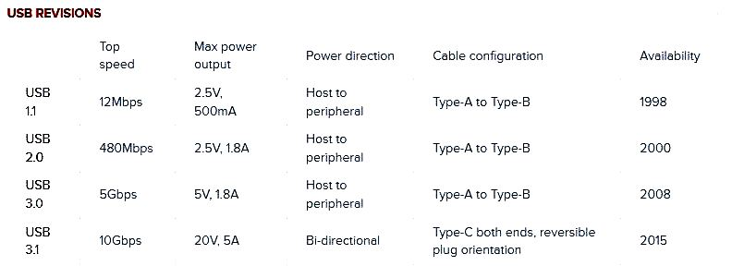
Connectors: USB (cont)
USB “Letter” standards refer to the physical design of the connector and the port
USB “Number” standards refer to the transmission speed and power of the cable
note: newer standards are backwards compatible (e.g. USB 3.1 cable works in USB 1.1 port at USB 1.1 speed/power)

Slide 26
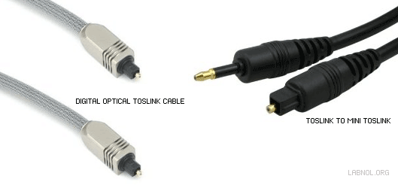


Connectors: Audio
Most commonly the standard headphone jack (TSR connector).
Available in several sizes, most commonly 3.5mm or ⅛” mini audio jack.
Can be color coded - microphone (pink), speaker (green).
For higher-end audio (e.g. DVD player) we can use fiberoptic cables.

Slide 27
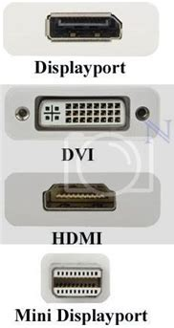
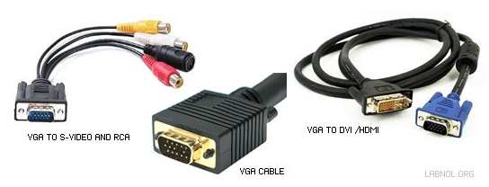
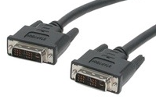
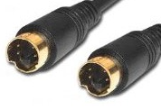
Connectors: Video
Standard VGA cable is commonly used for computer monitors (15-pins).
Converter cables connect VGA monitors to newer computers (HDMI or DVI).
MiniVGA is a variant found on laptops.
DVI is used on newer computers; MiniDVI and MicroDVI on “thin” laptops.
S-Video commonly used for DVD players, camcorders and older consoles.

Slide 28
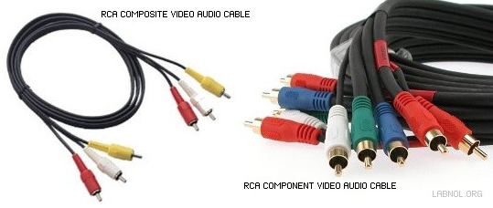
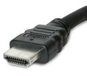
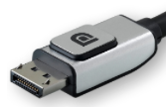
Connectors: Audio & Video
RCA cables include composite video (yellow) and stereo audio cables (red for right; white/black for left). Component video offers a better picture.
HDMI is the new standard for audio and video transmission in a single cable.
DisplayPort (and Mini DisplayPort) more commonly used in computers.

Slide 29
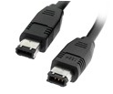

Connectors: Data
Firewire IEEE 1394 is a faster alternative to USB commonly used for external hard drives. Can also be used for networking. Usually 6-pin but also 4-pin.
eSATA is used internally to connect the hard drive to the motherboard but can also be used for portable hard drives (but cannot transmit power).

Slide 30
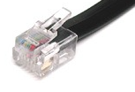
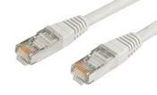
Connectors: Networking
Telephone cable (RJ11) used for connecting to the internet through DSL/ADSL modems. Standard phone cable has 4 wires; connector has 4 pins. Clip helps to maintain tight connection.
Ethernet (RJ45) is the standard for wired networking. Based on Cat5 twisted pair cable, made from 8 individual wires. Connector looks similar to phone plug but is thicker and wider. Also uses a clip to maintain tight connection.

Slide 31
Q & A
Notes:
In Slide Show mode, click the arrow to enter the PowerPoint Getting Started Center.

